Slide 1
INTRO to DATA SCIENCE Lecture 5: using visuals to explore and represent quantitative information
Notes:
~15-20 min on initial stuff
Note: example DS problem…write down some features, how could you build a predictive model from these?

Slide 2
Why data visualization?
“The greatest value of a picture is when it forces us to notice what we never expected to see.”
~ John Tukey, Data Analysis 1977
Notes:
You’re here because you’ve heard of it & you want to know more!

Slide 3
EDA AND VISUALIZATION
Exploratory Data Analysis (EDA) and Visualization are important (necessary?) steps in any analysis task.
Get to know your data!
distributions (symmetric, normal, skewed)
data quality problems
outliers
correlations and inter-relationships
subsets of interest
suggest functional relationships
Sometimes EDA or visualization might be the goal!

Slide 4
Exploratory Data Analysis (EDA)
Goal: get a general sense of the data
means, medians, quantiles, histograms, boxplots
You should always look at every variable - you will learn something!
Data-driven (model-free)
Think interactive and visual
Humans are the best pattern recognizers
You can use more than 2 dimensions!
x,y,z, space, color, time
Especially useful in early stages of analysis
detect outliers (e.g. assess data quality)
test assumptions (e.g. normal distributions or skewed?)
identify useful raw data & transforms (e.g. log(x))
Bottom line: it is always well worth looking at your data!

Slide 5
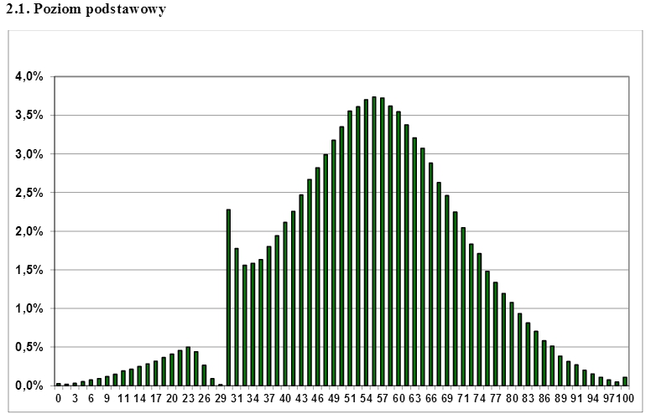
Exercise – why visualize data?
Distribution of results of the Matura (high school exit exam) in Poland

Slide 6
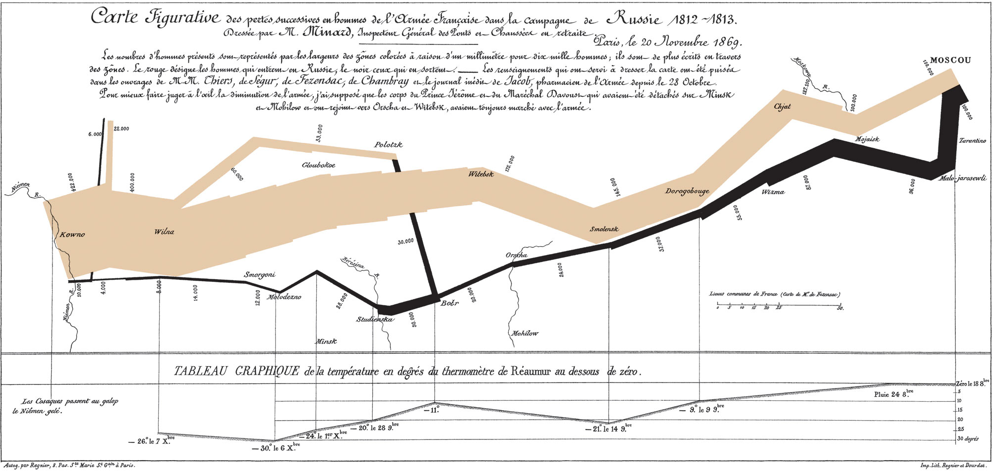
Napoleon’s march

Slide 7
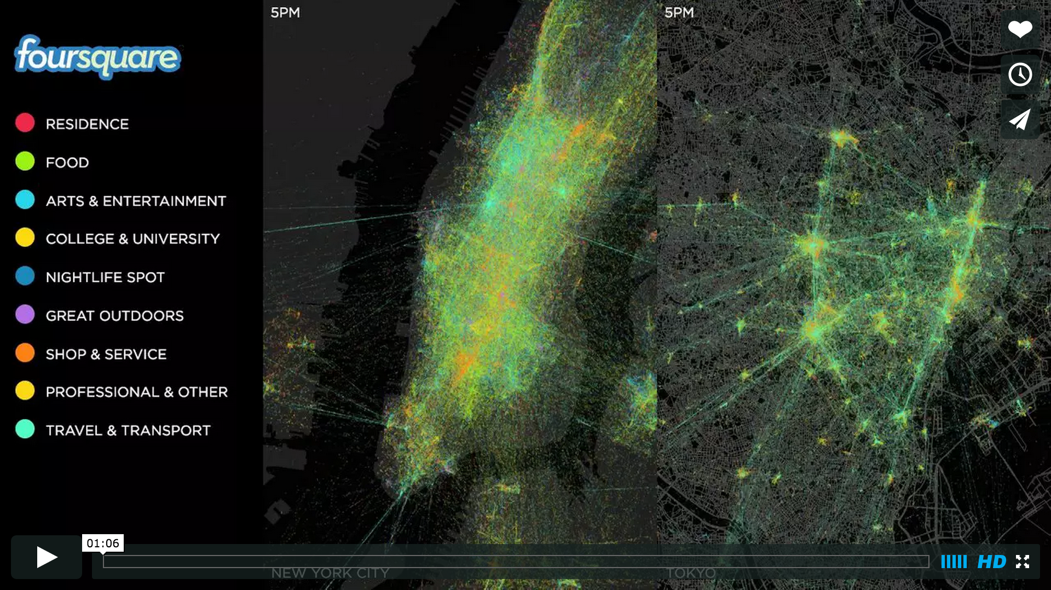
What is DATA SCIENCE?
The greatest value of a picture is when it forces us to notice what we never expected to see. (John Tukey, Data Analysis 1977)
Foursquare checkin data:
https://vimeo.com/62289901
Notes:
You’re here because you’ve heard of it & you want to know more!

Slide 8
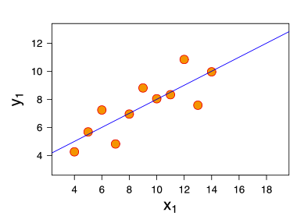
Exercise – why visualize data?
Consider the following dataset:
eleven (x, y) points
mean of x = 9, mean of y = 7.5
variance of x = 11, variance of y = 4.1
correlation of x, y = 0.8
line of best fit: y = 3.00 + 0.500x
Notes:
Q: Does everyone know what a line of best fit is?
Q: More importantly, do you know what the line of best fit tells you? (note: we will look at this next time)

Slide 9
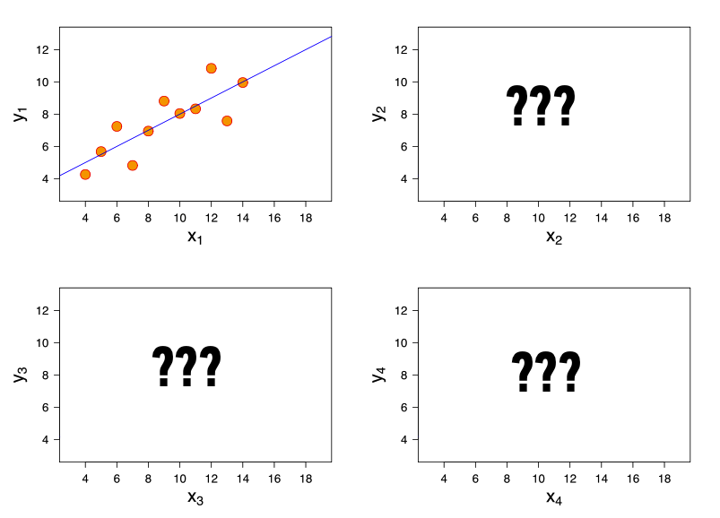
Exercise – why visualize data?
Now, suppose I give you
three more datasets
with exactly the same
characteristics…
Q: how similar are these datasets?

Slide 10
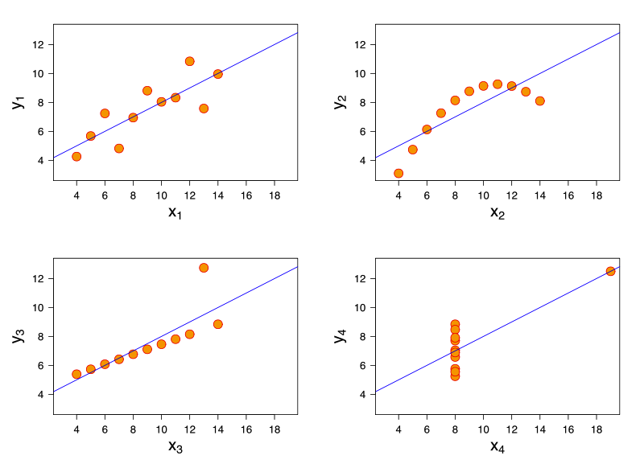
Exercise – why visualize data? (Anscombe’s quartet)
Now, suppose I give you
three more datasets
with exactly the same
characteristics.
Q: how similar are these datasets?
A: not very!
http://en.wikipedia.org/wiki/Anscombe's_quartet

Slide 11
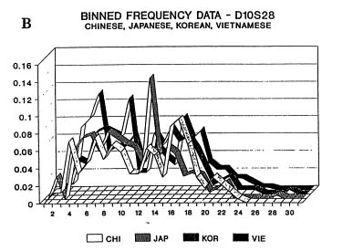
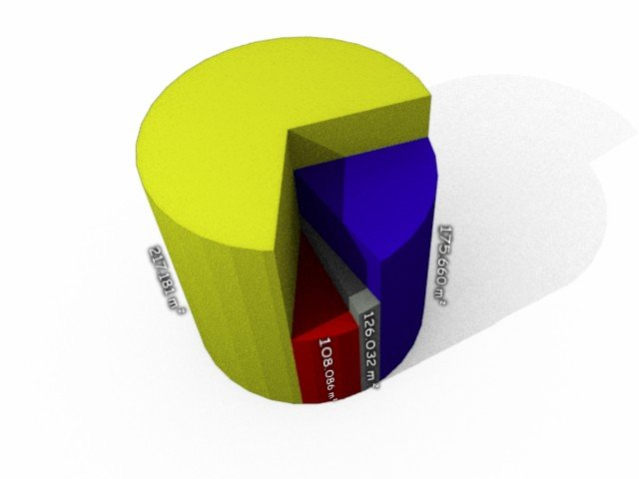
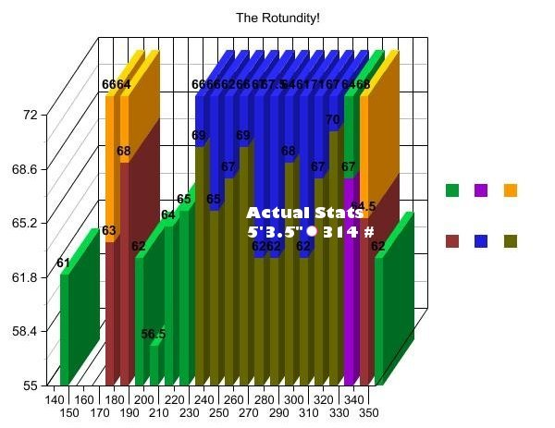
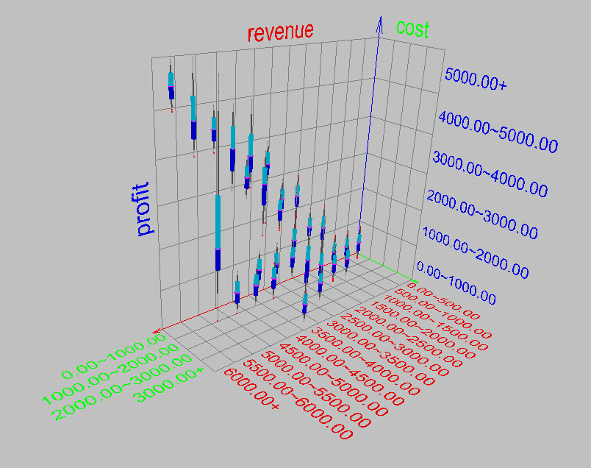
BUT BAD VISUALIZATIONS CAN DO MORE HARM THAN GOOD!

Slide 12
Issues with Histograms
For small data sets, histograms can be misleading.
Small changes in the data, bins, or anchor can deceive
For large data sets, histograms can be quite effective at illustrating general properties of the distribution.
Histograms effectively only work with 1 variable at a time
But ‘small multiples’ can be effective

Slide 13
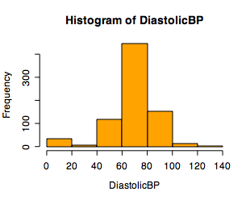
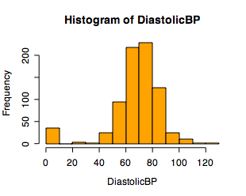
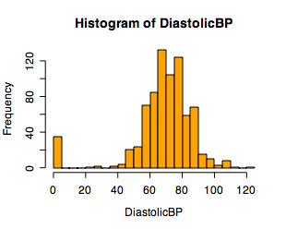
Single Variable Visualization
Histogram:
Shows center, variability, skewness, modality,
outliers, or strange patterns.
Bins matter
Beware of real zeros

Slide 14
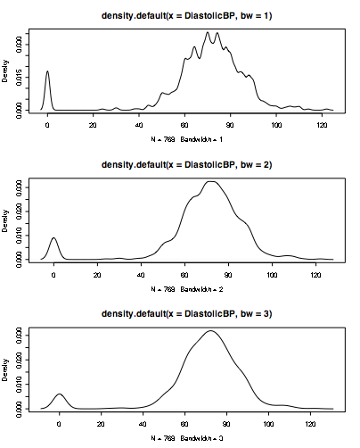
Bandwidth choice is an art
Usually want to try several

Slide 15
Summary Statistics
Not visual
Sample statistics of data X:
mean: μ = ∑_{i} X_{i} / n
mode: most common value in X
median: X=sort(X), median = X_{n/2} (half below, half above)
quartiles of sorted X: Q1 value = X_{0.25n}, Q3 value = X_{0.75 n}
interquartile range: value(Q3) - value(Q1)
range: max(X) - min(X) = X_{n} - X₁
variance: σ² = ∑_{i} (X_{i} - μ)² / n
skewness: ∑_{i} (X_{i} - μ)³ / [ (∑_{i} (X_{i} - μ)²)^{3/2} ]
zero if symmetric; right-skewed more common (what kind of data is right skewed?)
Number of distinct (Unique) values for a variable
Don’t need to report all of these: Bottom line…do these numbers make sense???

